Slide 1
DEP Solid Waste Section Responsibilities and Support Roles Catastrophic Mass Animal Casualty Events
Solid Waste Section Francine Joyal, Environmental Specialist
January 25, 2011

Slide 2
Solid Waste Section and Emergency Response
State Emergency Response Team (SERT) http://www.floridadisaster.org/index.asp
Florida Division of Emergency Management
Operate the State Warning Point
State Agencies are part of the SERT Emergency Support Functions (ESF) - http://www.floridadisaster.org/EMTOOLS/esf.htm
Agency ESFs involved with mass animal casualty events:
State Agricultural Response Team (SART) - the DOACS Team – ESF 17
Bureau of Emergency Response (BER) - the DEP Team - ESF 10
Emergency Operations Section – the DOH Team – ESF 8
Solid Waste Section responds to BER requests

Slide 3
Carcass Disposal Options
Listed in order of preference based on Zoonotic and Non-Zoonotic flowcharts found at http://www.flsart.org/ACMWG/documents/documents.htm
On-site burial
On-site composting
On-site incineration (Air Resource Management – John Glunn)
Off-site Class I landfill disposal
Processed by rendering company (USDA)
Off-site burial
Off-site composting
Off-site incineration

Slide 4
Investigation and Response Flowchart
Bird Carcass Decision Tree
Found on http://www.flsart.org/ACMWG/documents/documents.htm
Consider applying to all animal casualty events

Slide 5
Solid Waste Section
The Solid Waste Section is responsible for implementing the State's solid waste management program in accordance with Section 403.705, Florida Statutes. Activities include:
Providing guidelines for solid waste management in Florida
Facilitating development and promulgation of rules and policies
Reviewing and approving:
Permit or registration applications
Requests for variances
Request for alternate procedures and requirements

Slide 6
Solid Waste Section
Solid Waste Section subsections:
Facilities –
Landfill Design and Operation
Waste Processing Facilities
Database Management and Coordination
Special Waste –
Organics Processing & Recycling
Waste Tires
Resource Recovery Equipment Tax Credit
Biomedical Waste
Financial Assurance - Review Financial Documents for Compliance

Slide 7
Solid Waste Roles & Responsibilities
Regulations
Compliance
Waivers, including temporary authorizations
An Executive Order and/or Emergency Order are required to waive solid waste regulations.
Facilities & Locations
Database queries, contact lists, industry knowledge
District notification and coordination.
Technical Support
Guidance on management methods – burial, composting, landfill disposal, other methods that become applicable

Slide 8
Solid Waste Roles & Responsibilities
Regulations
Compliance
Waivers, including temporary authorizations
An Executive Order and/or Emergency Order are required to waive solid waste regulations.
Facilities & Locations
Database queries, contact lists, industry knowledge
District notification and coordination.
Technical Support
Guidance on management methods – burial, composting, landfill disposal, other methods that become applicable

Slide 9
Relevant Solid Waste Regulations
Solid Waste, 62-701, F.A.C.
Solid waste prohibitions (62-701.300, F.A.C.).
Solid waste management facility permit requirements, general (62-701.320)
Special waste handling – biological waste (62-701.520(5), F.A.C.)
Routine Disposal of Animal Carcasses
Treated biomedical waste disposal
Criteria for Organics Processing and Recycling, 62-709, F.A.C.
General Provisions (62-709.300, F.A.C.)
Normal farming exemptions (62-709.305(2), F.A.C.)
Design Criteria for Permitted Facilities (62-709.500, F.A.C.)
Operating Criteria for Permitted Facilities (62-709.510, F.A.C.)
Testing requirements (62-709.530(1), F.A.C.)
Compost classification (62-709.550, F.A.C.)
Criteria for off-site use of compost (62-709.600, F.A.C.)

Slide 10
Waivers
Chapter 120, F.S. authorized DEP issue secretarial Emergency Orders.
Prefer the Governor issue an Executive Order before DEP issues an Emergency Order.
Emergency Order waivers can include temporary authorizations for activities that would violate DEP rules.

Slide 11
Solid Waste Roles & Responsibilities
Regulations
Compliance
Waivers, including temporary authorizations
An Executive Order and/or Emergency Order are required to waive solid waste regulations.
Facilities & Locations
Database queries, contact lists, industry knowledge
District notification and coordination.
Technical Support
Guidance on management methods – burial, composting, landfill disposal, other methods that become applicable

Slide 12
Database - Water Assurance Compliance System (WACS)
Facility reports extract basic information from the database (http://appprod.dep.state.fl.us/WWW_WACS/Reports/SW_Facility_Inventory_srch.asp).
The two class types relevant to mass animal causality incidents are:
Class I landfills
Source-separated Organics Processing Facilities (bulking agent sources).
Information extracted includes Facility ID, Facility and Class Status, Site address and Latitude and Longitude.

Slide 13
Other resources
List of top 20 Class I landfills - http://www.flsart.org/ACMWG/resources/resources.htm
Derived from the WACS facility report
Identifies cooperating Class I landfills
Identifies the appropriate site staff
Contains staff contact information
Solid Waste Facility Locator - http://ca.dep.state.fl.us/mapdirect/?focus=solidwaste
Map Direct: Solid Waste
Searchable by facility ID, county and other parameters
Can select aerial imagery for different time periods

Slide 14
Other resources – Facility Locator cont.
Search result by facility ID

Slide 15
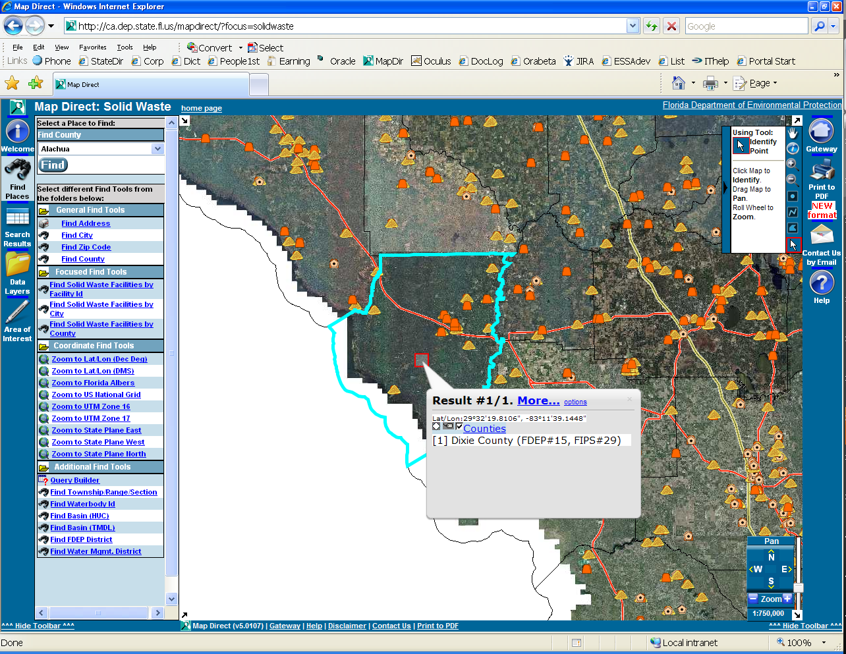
Other resources – Facility Locator cont.
Search result by County

Slide 16
Staff Industry Knowledge Topics
Landfill proximity
Water quality protection
Composting
Option evaluation for burial, composting or landfill disposal
Area identification and calculations for disposal or composting
Bulking agent requirements for composting
Potential sources of bulking agent

Slide 17
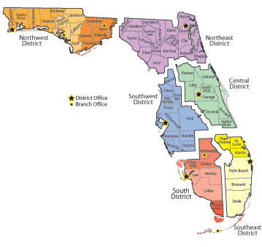
District involvement
DEP ESF notifies district of situation
Staff evaluation and inspection

Slide 18
Solid Waste Roles & Responsibilities
Regulations
Compliance
Waivers, including temporary authorizations
An Executive Order and/or Emergency Order are required to waive solid waste regulations.
Facilities & Locations
Database queries, contact lists, industry knowledge
District notification and coordination.
Technical Support
Guidance on management methods – burial, composting, landfill disposal, other methods that become applicable

Slide 19
Carcass Management Considerations
Storage time will be as short as possible – Carcass Disposal Executive Summary, Introduction to Part I (http://www.flsart.org/ACMWG/carcass_disposal_guidance/carcass.htm)
Processing overseen by DOACS, USDA or DOH – Bird Carcass Decision Tree (http://www.flsart.org/ACMWG/documents/documents.htm)
Hierarchy of management methods – Solid Waste Section Support
On-site burial
On-site composting
Off-site landfill disposal
Off-site burial
Off-site composting

Slide 20
Evaluation and Guidance for On-site Burial
Preferred Option when viable
On-site disposal evaluation considerations
Geologic conditions -- karst areas
Protect water resources -- ground water, surface water, and wells
Determine type of on-site disposal
Trench
Aboveground burial
Calculate bulk density and space required
Identify available space
Identify rule(s) that may need to be waived – Prohibitions in 62-701.300, Airport Safety in 62-701.320

Slide 21
Evaluation and Guidance for On-Site Composting
Determine viability of on-site composting
Identify type and estimated number of carcass
Calculate bulk density of carcasses to be handled
Calculate amount of bulking material and staging area needed
Determine time restraints based on type of carcass
Identify space availability
Identify off-site sources of bulking material if option is viable
Location of yard trash processing facilities
Contact information
Identify rule(s) that may need to be waived – Airport Safety in Rule 62-701.320, F.A.C.

Slide 22
Disposal Evaluation for Off-site Landfill
Preferable to manage carcasses on site
Identify landfill(s) able and willing to accept carcasses
Estimate distance to receiving facility for evaluation
Handling protocol per potential receiving site
Scheduling of receipt
Daily volume constraints
Identify isolated receiving area or general working face
Relay landfill concerns and requirements for disposal
Health and safety issues
Decontamination procedures
Method of transport
Identify rule(s) that may need to be waived – Prohibitions in Rule 62-701.300, F.A.C.

Slide 23
Evaluation and Guidance for Off-site Burial
Consider when on-site management and off-site landfill disposal is not viable or inadequate
Off-site disposal evaluation considerations
Geologic conditions -- karst areas
Protect water resources -- ground water, surface water, and wells
Determine type of off-site disposal
Trench
Aboveground burial
Calculate bulk density and space required
Identify available space
Identify rule(s) that may need to be waived – Prohibitions in Rule 62-701.300, F.A.C.

Slide 24
Evaluation and Guidance for Off-Site Composting
Consider when on-site or off-site landfill options are not viable or inadequate
Determine viability of off-site composting
Identify type and estimated number of carcass
Calculate bulk density of carcasses to be handled
Calculate amount of bulking material and staging area needed
Determine time restraints based on type of carcass
Identify available space
Identify off-site sources of bulking material
Location of yard trash processing facilities
Contact information
Identify rule(s) that may need to be waived – Prohibitions in 62-701.300, Airport Safety in 62-701.320

Slide 25
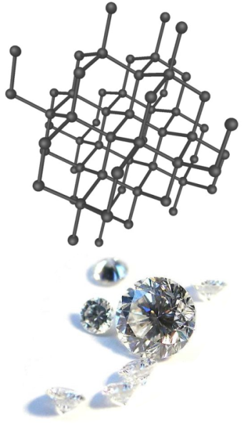
New Innovative Technologies
Matter-Antimatter Gun
Converts animal carcass to a carbon allotrope such as tetrahedral lattice arrangement known as a diamond

Slide 26
Contacts
Daniel M. Kuncicky, PhD
Environmental Manager
daniel.kuncicky@dep.state.fl.us
850.245.8786
Michell Smith
Engineering Specialist III
michell.m.smith@dep.state.fl.us
850 /245-8721
Francine Joyal
Environmental Specialist III
francine.joyal@dep.state.fl.us
850 /245-8747

Slide 27
Contact Information - General
Mailing address: DEP Solid Waste Section, MS 4565
2600 Blair Stone Road
Tallahassee, Florida 32399-2400
DEP Web Site: http://www.dep.state.fl.us/
Solid Waste Section Web Site:
http://www.dep.state.fl.us/waste/categories/solid_waste/default.htm

